Slide 1
Empower Training for Staff Advisors
November 6, 2020

Slide 2
Log into Empower

Slide 3
Click on red Menu Student Records and then on Student Dashboard

Slide 4
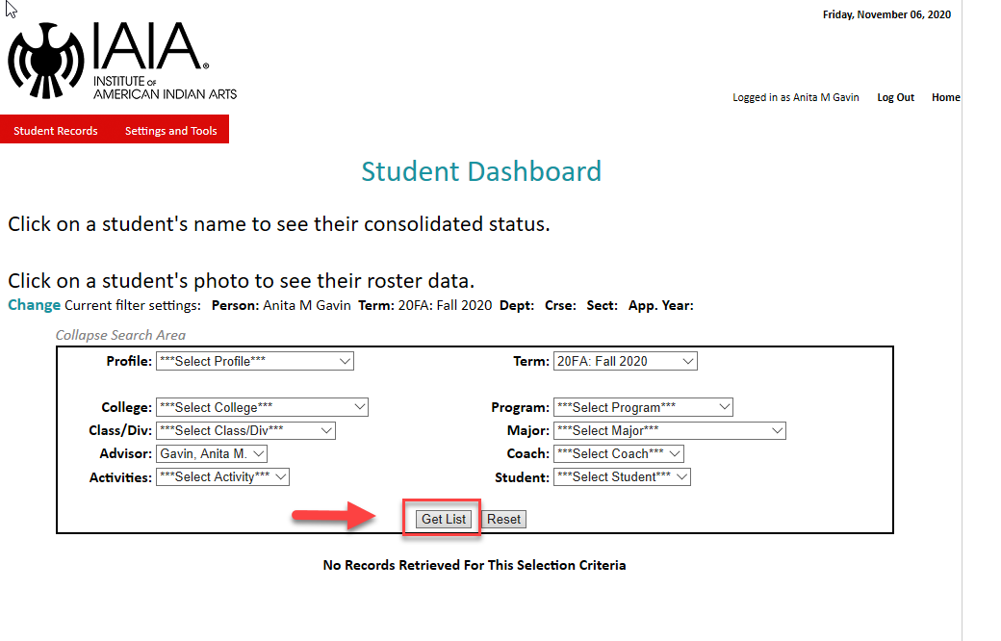
You will see this screen, click on Get List

Slide 5
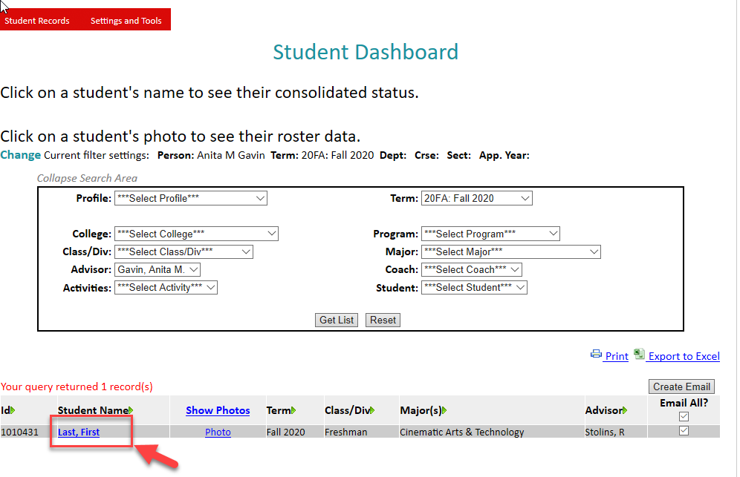
Only your advisees will show up on this screen. Click on the advisee name, in this case the student’s name is Last, First.

Slide 6
Click on Communications

Slide 7
You will see this screen

Slide 8
Options for communication
Can choose from the pull down: letter, email, direct contact or note
An email will always generate an email screen.

Slide 9
Options for action codes

Slide 10
Email
This communication type will always send an email.
Click on Continue button

Slide 11
Email Example

Slide 12
Email comment
An email will be sent to the student and a copy to yourself. The body of the email will appear in the comment section
Clicking the response button will add a date here and is optional

Slide 13
Manually logging a Communication Entry
Choose any Communication Type except email and the appropriate Action Code
In this case note is the communication type and comment is the action code

Slide 14
Logging a Communication Entry

Slide 15
Comment is logged here

Slide 16
Questions?
Contact: Anita Gavin anita.gavin@iaia.edu, phone 505-424-5701

