Slide 1


Counseling Services:
When & How to Refer Students

Slide 2
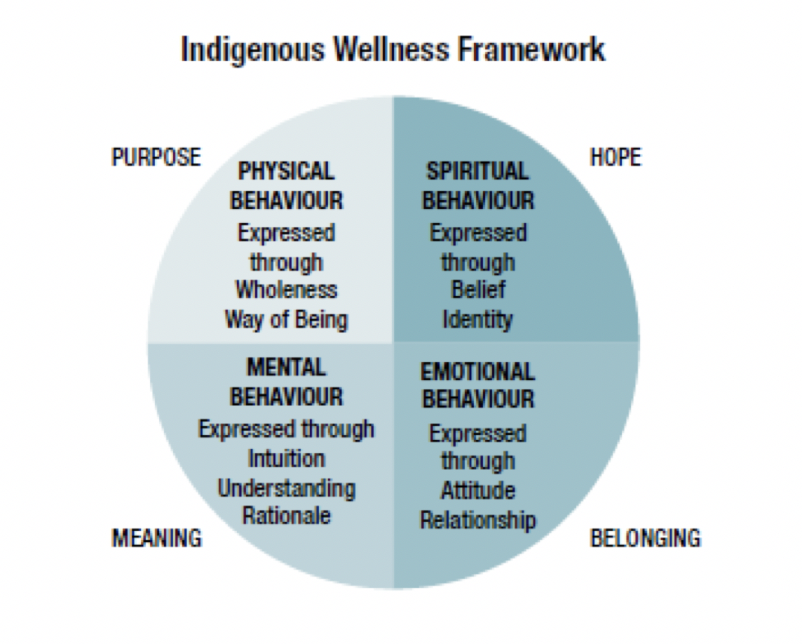
Counseling Team
Eliza Combs, MA, LPCC, ATR
Licensed Professional Clinical Counselor &
Registered Art Therapist
Madge Duus, MA, LMHC
Licensed Mental Health Counselor Specializing in Art Therapy
Mila Anguluan, PhD in Expressive Art Therapy
Licensure Pending, Counseling Intern
Our mission
To promote wellness, academic success, and retention in the IAIA college community by providing individual and group counseling, expressive arts, advocacy, experiential learning, resources, consultation and outreach.
We emphasize an indigenous wellness framework of meaning, belonging, purpose and hope.

Slide 3
Benefits of Investing in Students’ Mental Health
“Students who participate in campus counseling services generally report improvement in their mental health or attendance problem, and they report higher satisfaction with their quality of life.”
-Kognito White Paper, May 2015

Slide 4

Why refer?
Distressed Students
Students who are experiencing emotional or psychological problems that are interfering with their ability to learn
College transition is naturally a stressful time
More students coming to college with emotional or mental health issues
Many of our students are 1st generation college students
Many of our students are impacted by trauma

Slide 5
Your Role
A student’s behavior, especially if it is inconsistent with your previous observations, could well constitute an inarticulate attempt to draw attention to them. While asking about a student’s emotional well-being or confronting problematic behavior can be risky or seem intrusive, it is better to risk offending the student through a thoughtful intervention than fail to respond to distressed (and distressing) behavior. You are often perceived as the first point of contact in obtaining advice and support.
Some strategies that might prove helpful:
Personally model the behaviors students are expected to exhibit.
Hold students accountable for their actions.
Talk to the student of concern in private.
Express empathy.
Take a moment to care for your self when you need to (modeling)
Convey presence and understanding through body language and active listening.
Be as specific as possible in stating your observations and reason for any concern(s).
Listen carefully to everything the student says.
Repeat the essence of what the student has told you so your attempts to understand are communicated.
Avoid criticizing or sounding judgmental.
Consider Counseling Services as a resource and discuss referral information with the student. If the student resists referral and you remain uncomfortable with the situation, contact your Chair, supervisor or Counseling Services to discuss your concern.

Slide 6

Assisting Students in Distress
Solution-focused, positive strategies
For students:
Short-term personal counseling
Crisis intervention
Referral to campus and community resources
Academic and personal skills coaching
Workshops and presentations on mental health topics
Groups
For faculty and staff:
Individual consultation
Presentations to department meetings and classes

Slide 7
Staff Advisors –You have Spectrum of Skills
signs the conversation is getting too deep
For students:
They seem visibly disturbed, anxious, breathing changed
Zone Out
Talking in circles
Not coherent timeline, hard to understand
Many trauma stories in one sitting
For you:
You feel uncomfortable or overwhelmed
You feel pressure to solve, fix, give advice
You feel bad for the student

Slide 8

What you can say and do
For students:
Let’s take a break from this conversation for a minute.
I invite you to feel your feet on the ground.
Can I get you some water or tea.
It seems like you are ready to share some things about you in a deep way. I don’t really have training to assist you in this area. Would you be open to connecting to someone who does?
I really think it would be beneficial if you talked to one of our counselors about this too. Can we call them together?
For you:
Breath, Ground & Settle Yourself
Call support if you need/ assess concern, crisis, emergency
Trust yourself

Slide 9

When in doubt, check it out --- consult and refer.
“Let’s contact someone who can support you.”

Slide 10
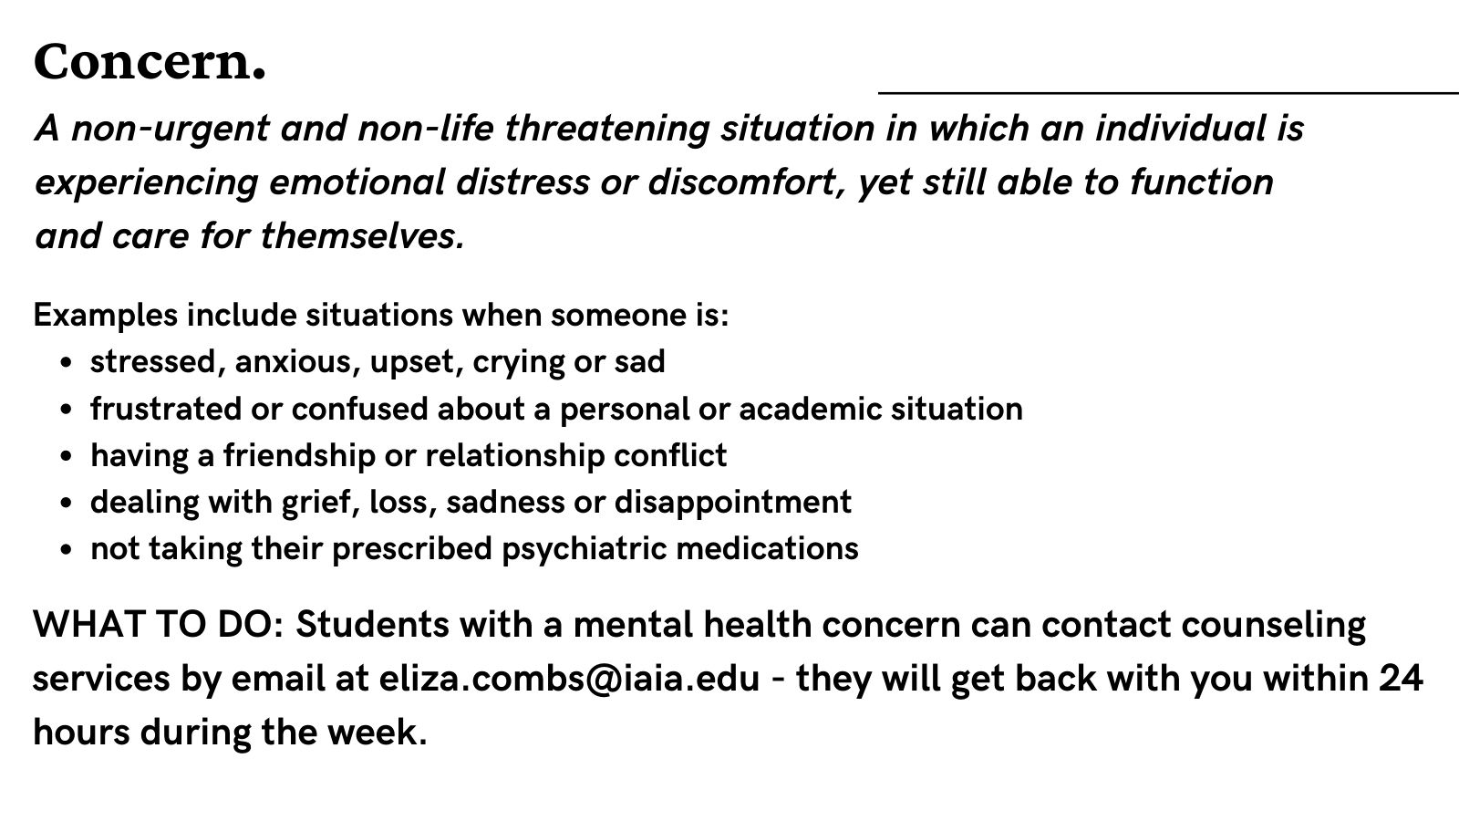
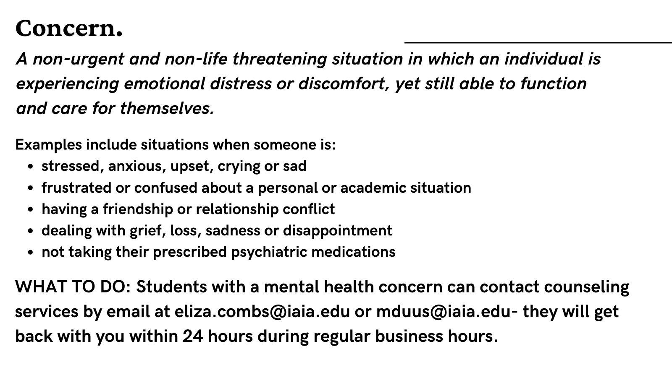

Slide 11

Assisting Students in Distress
LEVEL ONE: LOW RISK
Warning Signs | How to Respond
Pronounced and sudden change in attendance patterns: Tardiness Increased absences Change in Behavior: Withdrawn Irritable Confrontational Depressed Angry Negative change in attitude Significant change in the way the student interacts with staff and/or students | Meet with student individually. In a non-threatening and non-punitive fashion, comment on your observations of specific behaviors and express your concern. Inquire as to what circumstances may be causing the changes in behavior. Provide referral to counselor and/or resources. Consult with a counselor or colleague, if needed.

Slide 12
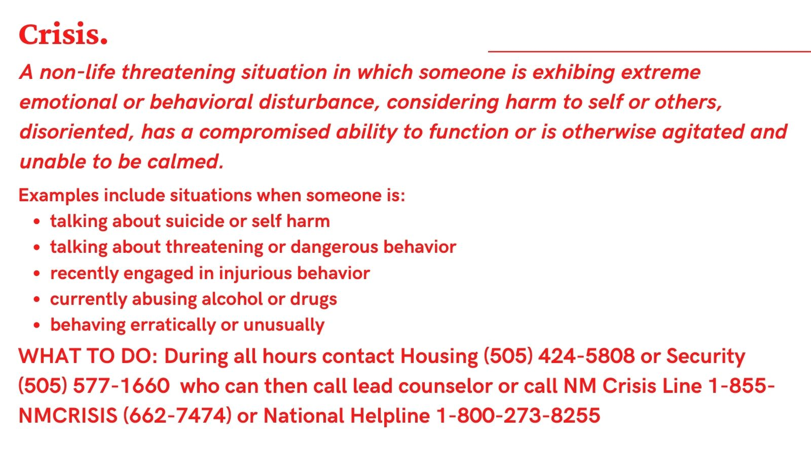


Slide 13

Assisting Students in Distress
LEVEL TWO: MODERATE RISK
Warning Signs | How to Respond
Negative/hostile attention-seeking behavior Threats to do harm to self or others (depending on severity, may be high risk): Jokes, sarcasm Hints Symbolic gestures Drawings Writing assignments Withdrawn behavior of increasing concern or vacant stare Openly confrontational No participation in class discussions and/or activities with passive-aggressive behaviors and acting out | Meet with student individually, if you feel safe. Express your interest in the student’s well-being. Consult with your chair/dean/supervisor. Submit an Early Alert https://airtable.com/shrR03fOvACGnbTpc Provide referral to counselor and/or resources. Consult with a counselor or colleague, if needed.

Slide 14
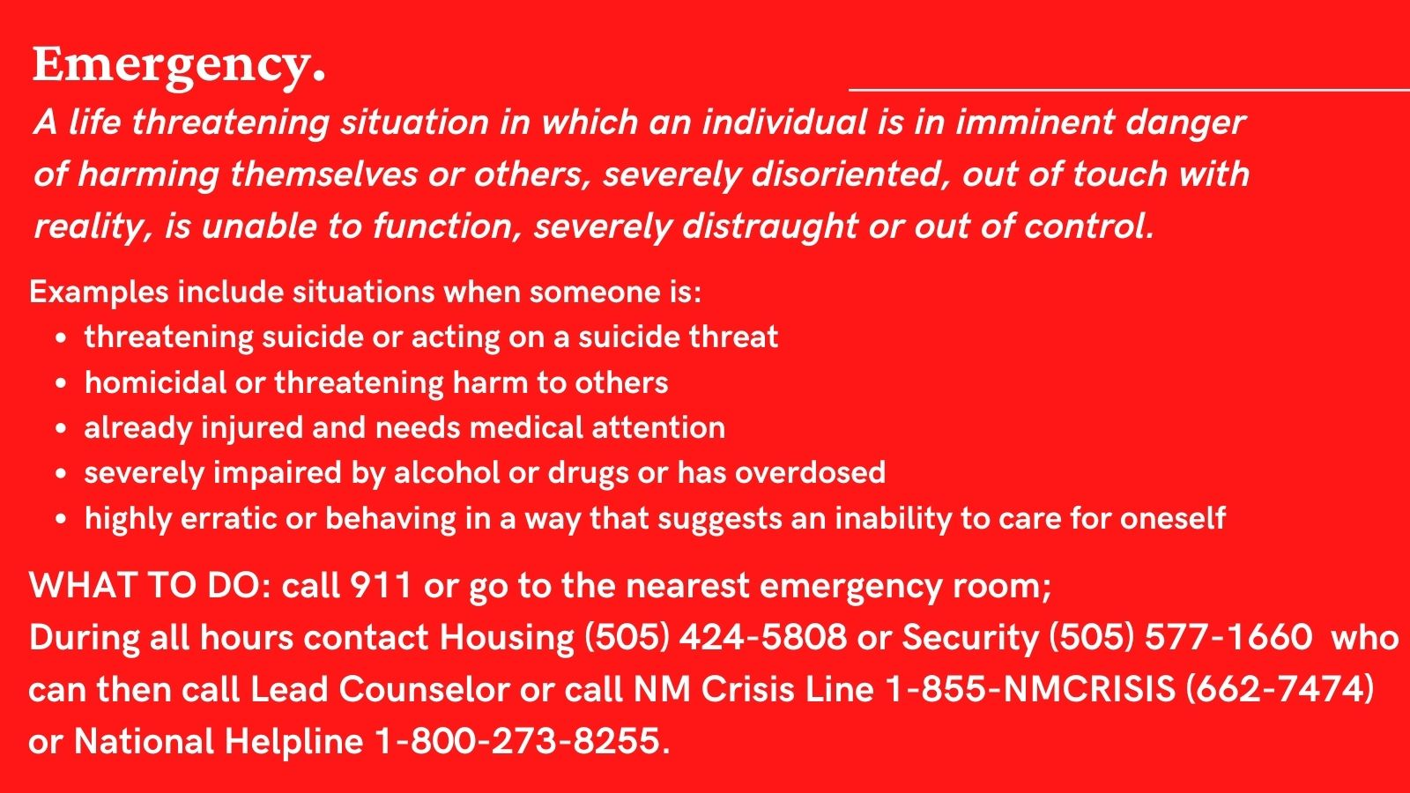

Slide 15


Assisting Students in Distress
LEVEL THREE: HIGH RISK, EMINENT DANGER EXISTS
Warning Signs | How to Respond
Continued demonstrations of odd or peculiar behavior Aggressive and threatening behavior or gestures Escalating threats, raised voices Visible agitation, physical tension, trembling Threatens to harm self or others Gravely impaired, confused, agitated, disoriented Out of touch with reality | Remain Calm; don’t engage in an argument. In threatening situations, keep a distance between you and the student, and allow the student a way to exit. Don’t allow yourself to become trapped. Reduce noise, talking, questions, and stimulation. Call Campus Security at (505) 577-1660 (on campus) or 911 (off campus) Notify area chair/dean/supervisor within 10 minutes of the incident.

Slide 16

Assisting Students in Distress Recap
For emergencies, call the police first!
On campus …………… (505) 577-1660
Off campus ……………………… 911
If the student is hostile, keep a distance and allow student to exit.
Meet in private (unless the student is hostile).
Stay calm, reduce noise and outside stimulation.
Describe your concerns, “I’ve noticed this, how can I help you?”
Listen and acknowledge the student’s concerns.
When in doubt, consult and refer. “Let’s contact someone who can help you.”
Share Counseling Services information if the student is reluctant (sometimes it takes a while to adjust to the idea!).
Share community resources and crisis hotlines, if applicable.

Slide 17
Assisting Students in Distress
To contact a counselor…
Student appointments*
Email eliza.combs@iaia.edu, mduus@iaia.edu or mila.anguluan@iaia.edu from their IAIA account (preferred) Call Counseling Services and leave a message at 505-424-5758
Resources Available @ https://iaia.libguides.com/mental_health_resources
Faculty and Staff Consultations*
Eliza Combs: Madge Duus:
eliza.combs@iaia.edu or leave message at 505-424-5758 mduus@iaia.edu or leave message at 505-424-2336
*Email is preferable and checked frequently throughout the day during business hours.

Slide 18
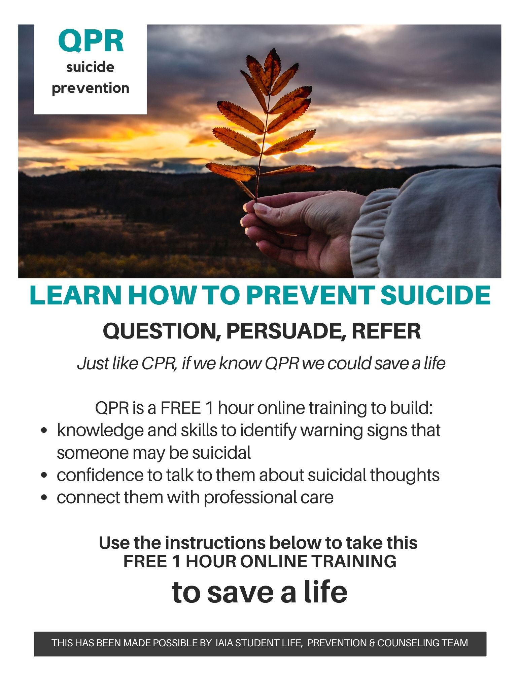

Slide 19

Thank You

